Slide 1
Module 3

Slide 2
Inheritance
Inheritance in Java is a mechanism in which one object acquires all the properties and behaviors of a parent object.
Inheritance enables us to reuse methods and fields of the parent class.
Moreover, you can add new methods and fields in your current class also.
Inheritance represents the IS-A relationship which is also known as a parent-child relationship.
Need for inheritance in java
For Method Overriding (so runtime polymorphism can be achieved).
For Code Reusability.

Slide 3
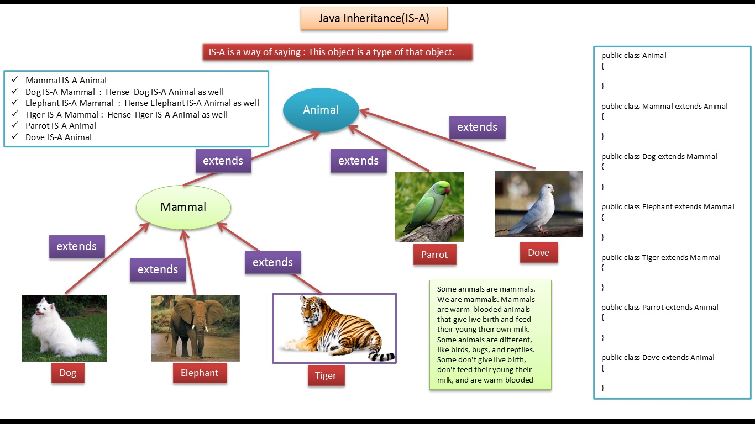

Slide 4
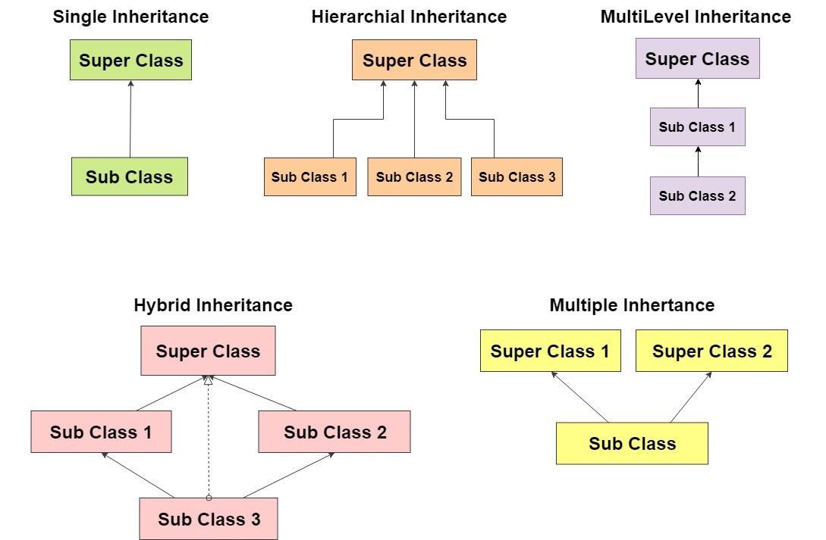
In Class level Java does not support Multiple Inheritance. But it can be implemented using interfaces

Slide 5
Demo On Inheritance

Slide 6
Aggregation – Has - A Relationship
Aggregation is a special form of association. It is a relationship between two classes like association, however its a directional association
It is strictly a one way association.
It represents a HAS-A relationship.
In Aggregation, both the entries can survive individually which means ending one entity will not effect the other entity
Aggregation Example in Java
Consider two classes Student class and Address class. Every student has an address so the relationship between student and address is a Has-A relationship.
But if you consider its vice versa then it would not make any sense as an Address doesn’t need to have a Student necessarily.

Slide 7
Example - Aggregation
class Address
{
int streetNum;
String city;
Address(int street, String c)
{
this.streetNum=street;
this.city =c;
}
}
public class StudentClass
{
int rollNum;
String studentName;
//Creating HAS-A relationship with Address class
Address studentAddr;
StudentClass(int roll, String name, Address addr){
this.rollNum=roll;
this.studentName=name;
this.studentAddr = addr;
}
public static void main(String args[]){
Address ad = new Address(55, "Agra");
StudentClass obj = new StudentClass(123, "Chaitanya", ad);
System.out.println(obj.rollNum+" "+obj.studentName);
System.out.println("Address : "+obj.studentAddr.streetNum+" "+obj.studentAddr.city);
}
}
OUTPUT :
123 Chaitanya
Address : 55 Agra

Slide 8
Why we need Aggregation?
To maintain code re-usability.
Considering the previous Example : Suppose there are two other classes College and Staff along with above two classes Student and Address.
In order to maintain Student’s address, College Address and Staff’s address we don’t need to use the same code again and again.
We just have to use the reference of Address class while defining each of these classes like:
Student Has-A Address (Has-a relationship between student and address)
College Has-A Address (Has-a relationship between college and address)
Staff Has-A Address (Has-a relationship between staff and address)

Slide 9
Example Extended - Need for Aggregation
class Address
{
int streetNum;
String city;
Address(int street, String c)
{
this.streetNum=street;
this.city =c;
}
}
class College
{
String collegeName;
//Creating HAS-A relationship
//with Address class
Address collegeAddr;
College(String name, Address addr){
this.collegeName = name;
this.collegeAddr = addr;
}
}
public class StudentClass
{
int rollNum;
String studentName;
//Creating HAS-A relationship with Address class
Address studentAddr;
StudentClass(int roll, String name, Address addr){
this.rollNum=roll;
this.studentName=name;
this.studentAddr = addr;
}
public static void main(String args[]){
Address ad = new Address(55, "Agra");
StudentClass obj = new StudentClass(123, "Chaitanya", ad);
Address col = new Address(1, "Vellore");
College cl = new College("VIT",col);
System.out.println(obj.rollNum+" "+obj.studentName);
System.out.println("Address : "+obj.studentAddr.streetNum+" "+obj.studentAddr.city);
System.out.println("College Name : "+cl.collegeName);
System.out.println("Address : "+cl.collegeAddr.streetNum+" "+cl.collegeAddr.city);
}
}
OUTPUT :
123 Chaitanya
Address : 55 Agra
College Name : VIT
Address : 1 Vellore

Slide 10
Composition in Java
Composition is a special case of aggregation.
A restricted form aggregation is called composition.
When an object contains the other object and the contained object cannot exist without the other object, then it is called composition.
Both the entities are dependent on each other.

Slide 11
Example - Composition
class Bike
{
// declaring data members and methods
private String color;
private int wheels;
public void bikeFeatures()
{
System.out.println("Bike Color= "+color + " wheels= " + wheels);
}
public void setColor(String color)
{
this.color = color;
}
public void setwheels(int wheels)
{
this.wheels = wheels;
}
}
class Honda extends Bike
{
//inherits all properties of bike class
public void setStart()
{
HondaEngine e = new HondaEngine();
e.start();
}
}
class HondaEngine
{
public void start()
{
System.out.println("Engine has been started.");
}
public void stop()
{
System.out.println("Engine has been stopped.");
}
}

Slide 12
Example – Composition Contd…
Program – Explanation
The above code contains three class - Class Bike, Class Honda, Class HondaEngine
Class Honda – Inherits Bike class and Has a Engine
Honda Class uses Honda Engine class, start() method via composition
Honda Engine (object) is used in Honda Bike (Class)
//Driver Class containing main method
class CompositionDemo
{
public static void main(String[] args)
{
Honda h = new Honda();
h.setColor("Black");
h.setwheels(2);
h.bikeFeatures();
h.setStart();
}
}
OUTPUT :
Bike color= Black wheels= 2
Engine has been started

Slide 13
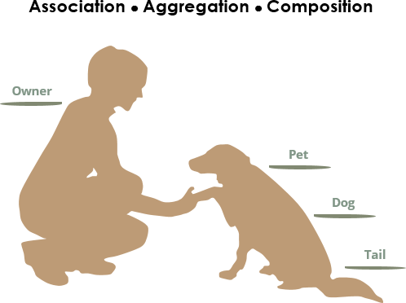
Relationship in Java - Summary
We see the following relationships:
Owners feed pets, pets please owners (association)
A tail is a part of both dogs and cats (aggregation / composition)
A cat is a kind of pet (inheritance / generalization)

Slide 14
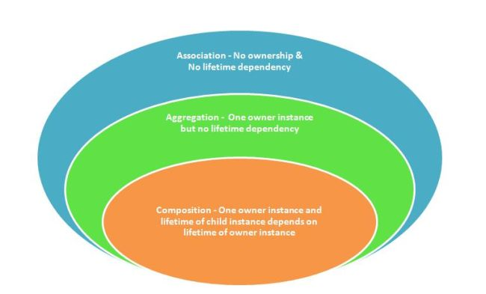
Relationship in Java - Summary
To sum it up association is a very generic term used to represent when on class used the functionalities provided by another class.
We say it's a composition if one parent class object owns another child class object and that child class object cannot meaningfully exist without the parent class object.
If it can then it is called Aggregation.

Slide 15
Assignments

Slide 16
Mcqs
1.Which is true?
A "X extends Y" is correct if and only if X is a class and Y is an interface
B. "X extends Y" is correct if and only if X is an interface and Y is a class
C."X extends Y" is correct if X and Y are either both classes or both interfaces
D. "X extends Y" is correct for all combinations of X and Y being classes and/or interfaces

Slide 17
2. What is the result of compiling and running the following code?
class Base{
public Base(){
System.out.print("Base");
}
}
public class Derived extends Base{
public Derived(){
this(“Smart");
System.out.print("Derived");
}
public Derived(String s){
System.out.print(s);
}
public static void main(String[] args){
new Derived();
}
}
A. SmartDerived
B. SmartBaseDerived
C. BaseSmartDerived
D. SmartDerivedBase
E. Compilation Error

Slide 18
3. class Mammal{
void eat(Mammal m){
System.out.println("Mammal eats food");
}
}
class Cattle extends Mammal{
void eat(Cattle c){
System.out.println("Cattle eats hay");
}
}
class Horse extends Cattle{
void eat(Horse h){
System.out.println("Horse eats hay");
}
}
public class Test{
public static void main(String[] args){
Mammal h = new Horse();
Cattle c = new Horse();
c.eat(h);
}
}
A. prints "Mammal eats food"
B. prints "Cattle eats hay"
C. prints "Horse eats hay"
D. Class cast Exception at runtime.
E. None of these

Slide 19
4. Determine output:
class A
{
public void method1(){
System.out.print("Class A method1");
}
}
class B extends A
{
public void method2()
{
System.out.print("Class B method2");
}
}
class C extends B
{
public void method2()
{
System.out.print("Class C method2");
}
public void method3()
{
System.out.print("Class C method3");
}
}
public class Test{
public static void main(String args[]){
A a = new A();
C c = new C();
c.method2();
a = c;
a.method3();
}
}
A. Class B method2 Class C method3
B. Class C method2 Class C method3
C. Compilation Error
D. Runtime exception
E. None of these

Slide 20
5. class Parent{
public void method(){
System.out.println("Hi i am parent");
}
}
public class Child extends Parent{
protected void method(){
System.out.println("Hi i am Child");
}
public static void main(String args[]){
Child child = new Child();
child.method();
}
}
A. Compiles successfully and print
B. Compiles successfully and print
C. Compile time error
D. Run Time error
E. None of This

Slide 21
6. What will be the output?
class One{
final int a = 15;
}
class Two extends One{
final int a = 20;
}
public class Test extends Two{
final int a = 30;
public static void main(String args[]){
Test t = new One();
System.out.print(t.a);
}
}
A. 15
B. 20
C. 30
D. Compiler Error
E. None of these

Slide 22
7. class A{
A(String s){}
A(){}
}
1. class B extends A{
2. B(){}
3. B(String s){
4. super(s);
5. }
6. void test(){
7. // insert code here
8. }
9. }
Which of the below code can be insert at line 7 to make clean compilation ?
A. A a = new B();
B. A a = new B(5);
C. A a = new A(String s);
D. All of the above
E. None of these

Slide 23
C
C
A
C
C
D
A

